Slide 1
An Opinionated Approach to ASP.NET Core
(50 opinions, to be exact)
K. Scott Allen
@OdeToCode

Slide 2
Solutions and Projects
Controllers
C# Code
Views
Startup
Client Code
Tests

Slide 3

Solutions & Projects
3

Slide 4
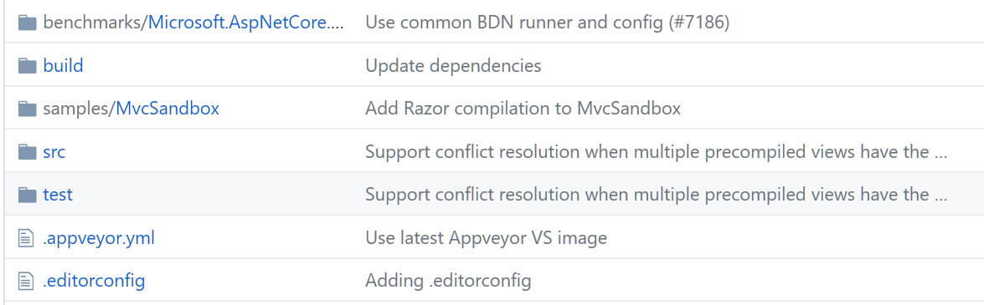
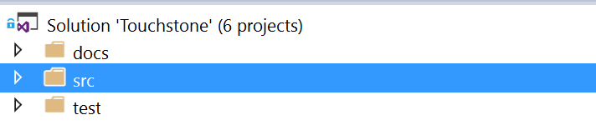
Use a Standard Repo Structure

Slide 5
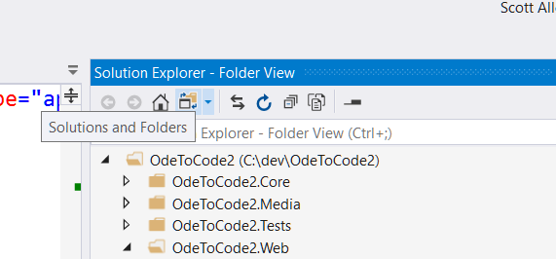
Use Folder View

Slide 6
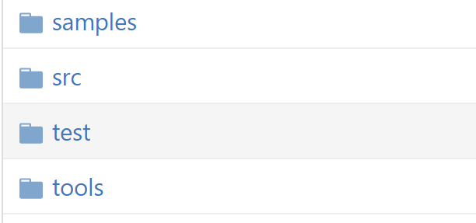
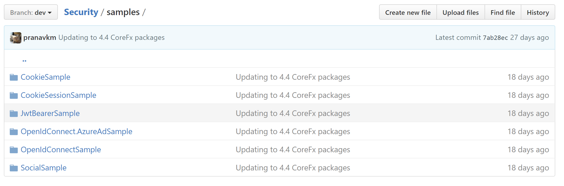
Include Samples & Tools

Slide 7
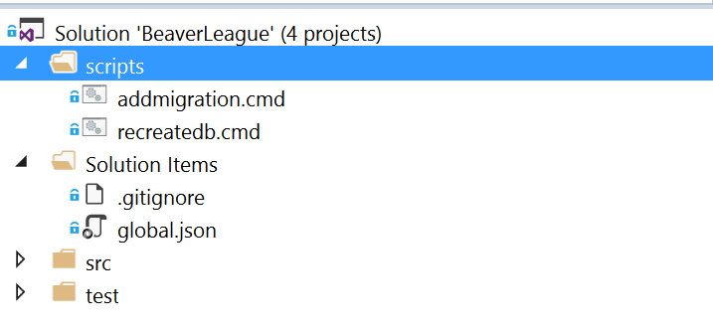
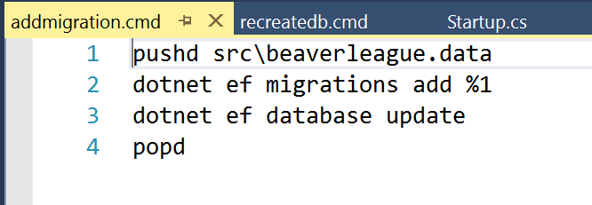
Include Development Scripts

Slide 8
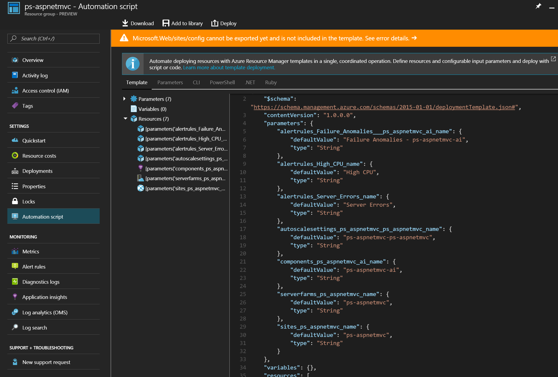
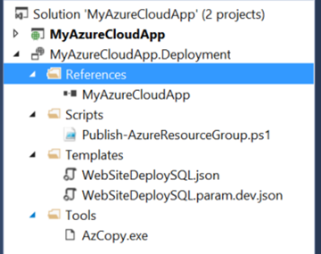
Include Deployment Scripts & Templates

Slide 9
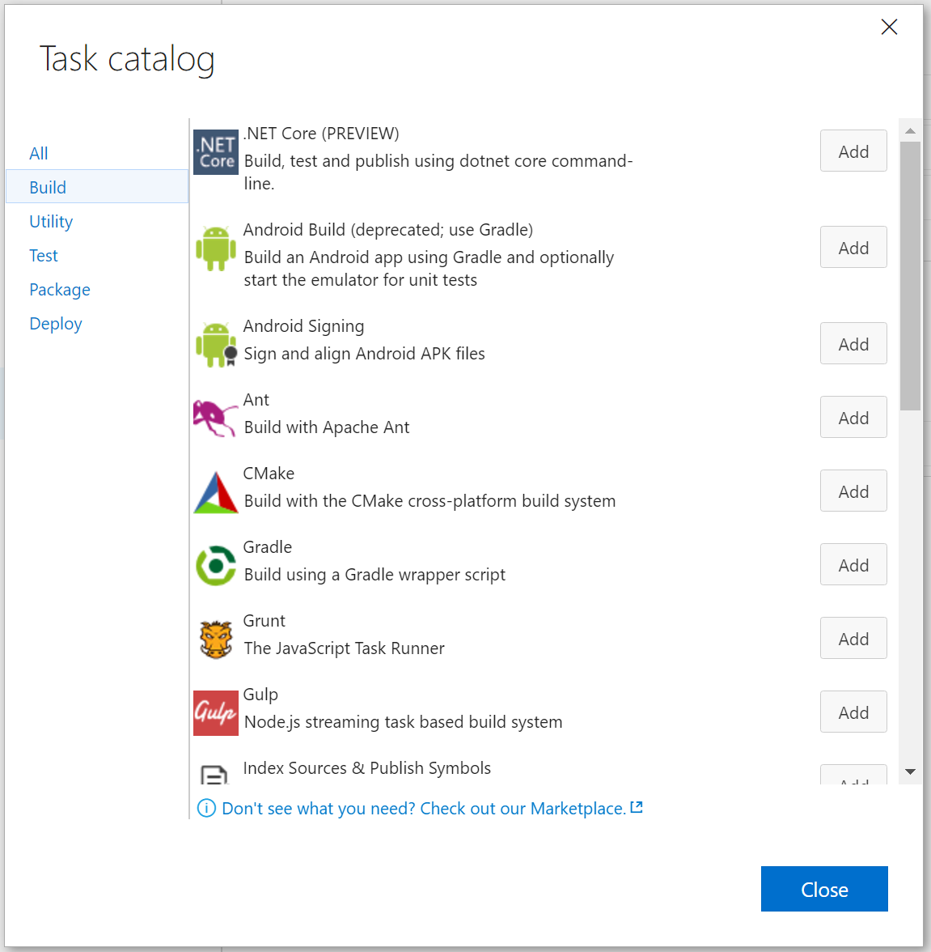
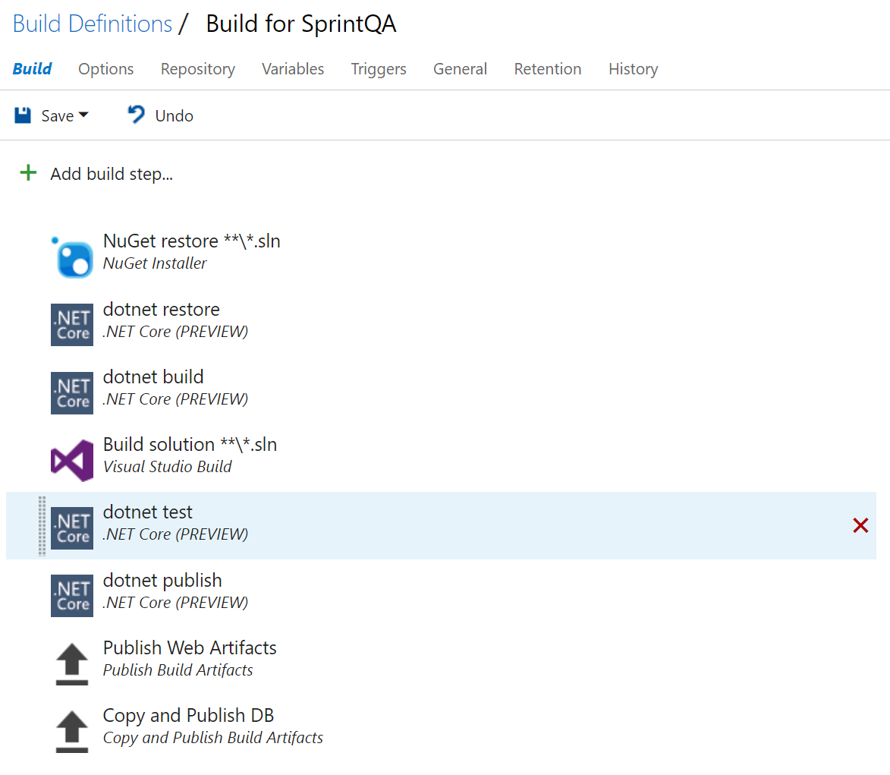
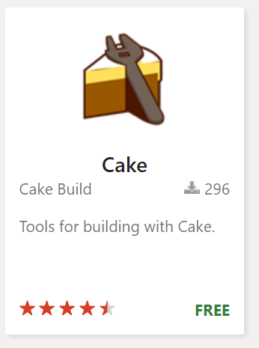
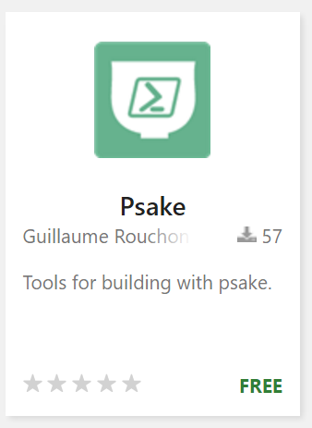
Use YAML for VSO Builds (and Releases!)

Slide 10
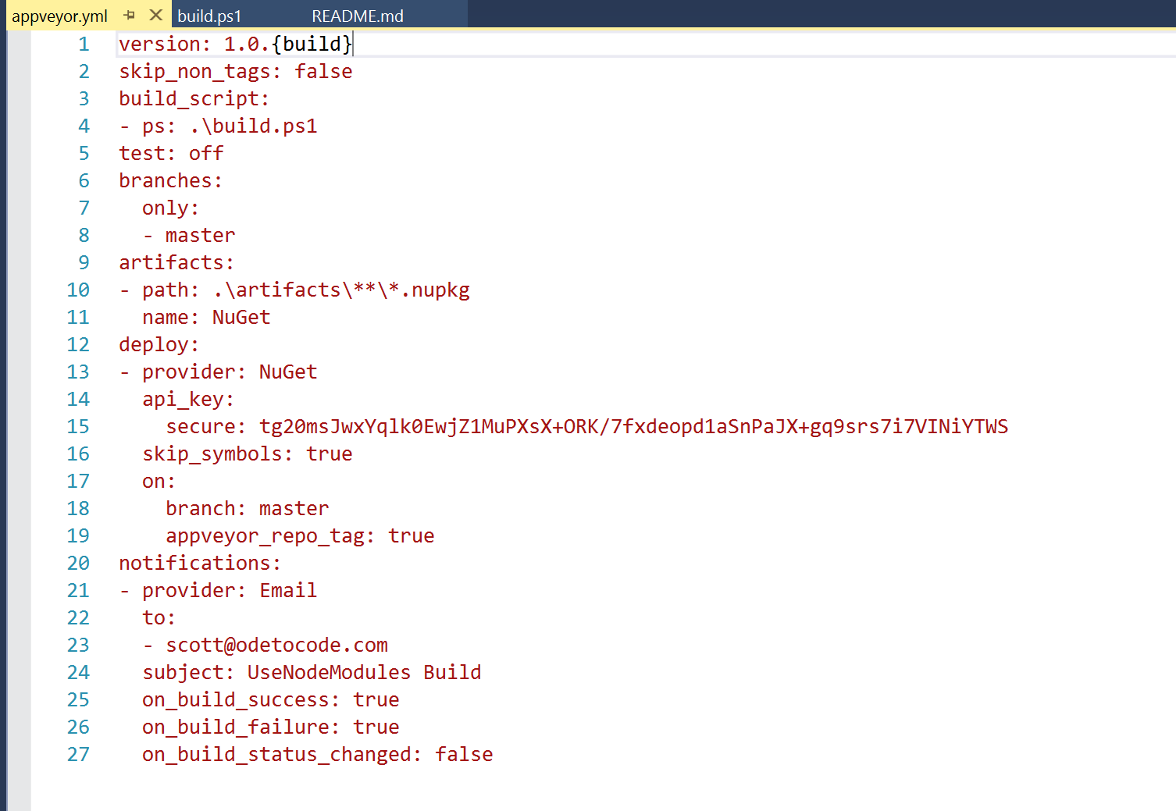
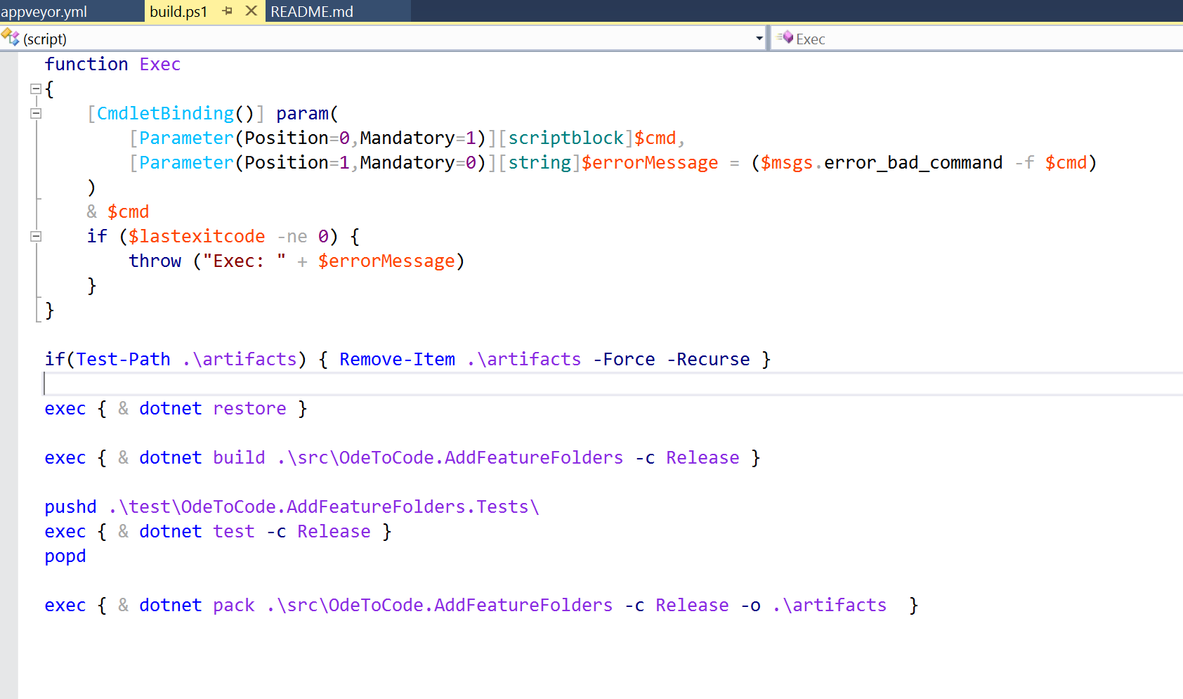
Use AppVeyor YAML for Builds Instead of UI

Slide 11

Startup
11

Slide 12
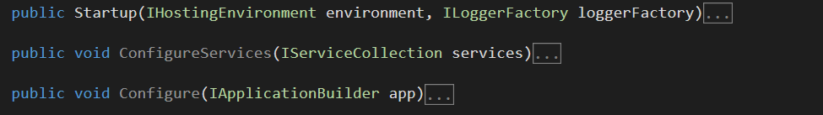
Only Use Startup for Services and Middleware
Startup has two responsibilities

Slide 13
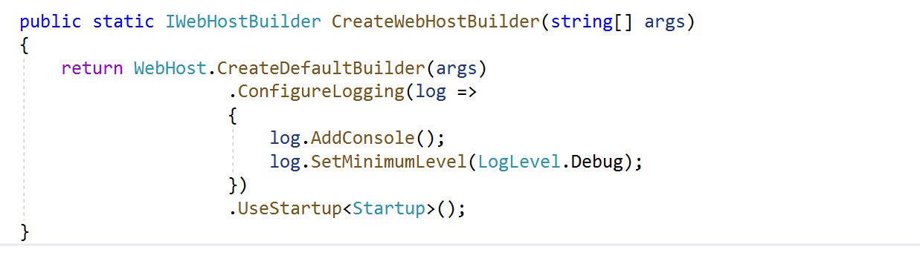
Logger Is Configured Before Middleware
Leave Configure for middleware only

Slide 14
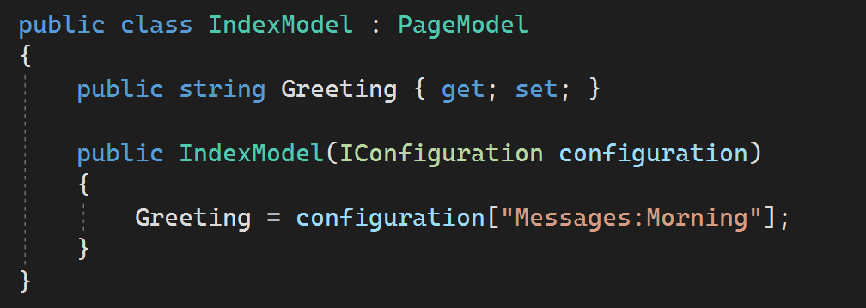
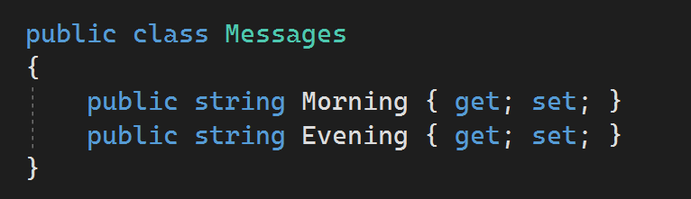
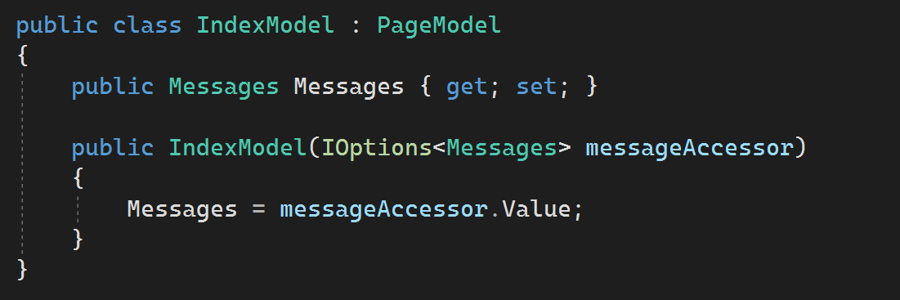
Use the Options Pattern

Slide 15
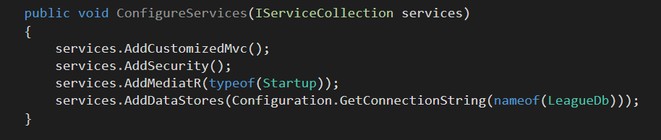
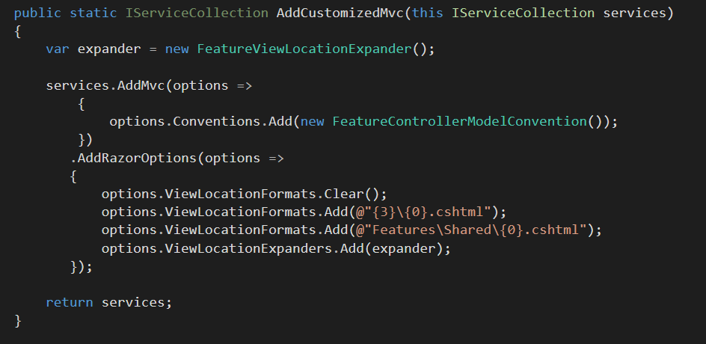
Keep Configure Methods Clean

Slide 16
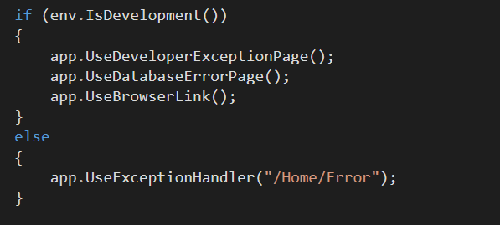
Configure Is Allowed To Branch

Slide 17
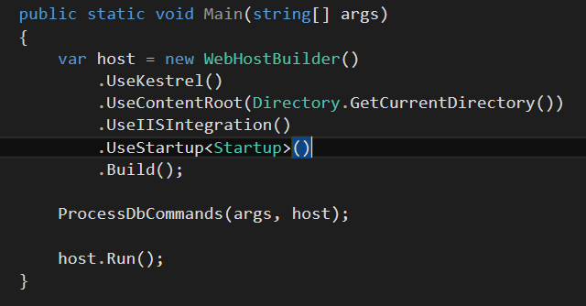
Make Use Of Your App As Executable

Slide 18
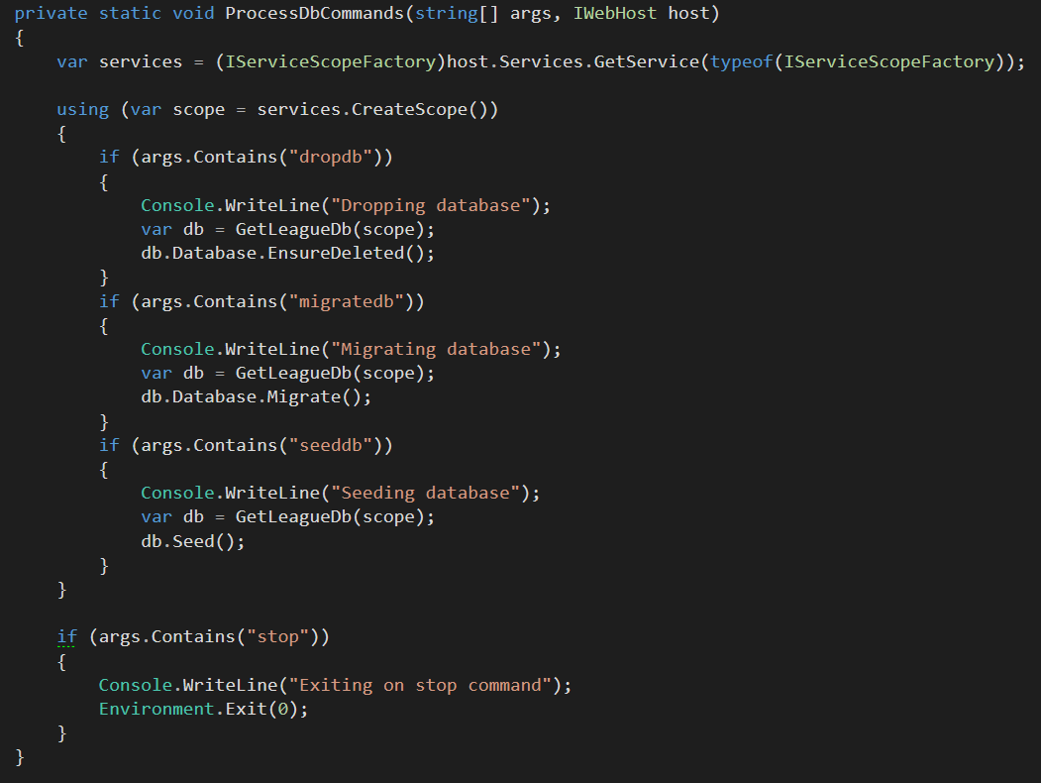
Always Use IServiceScopeFactory During Startup

Slide 19
Use DbContext Pools

Slide 20
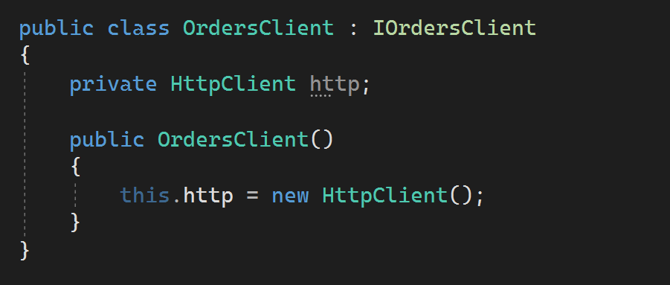
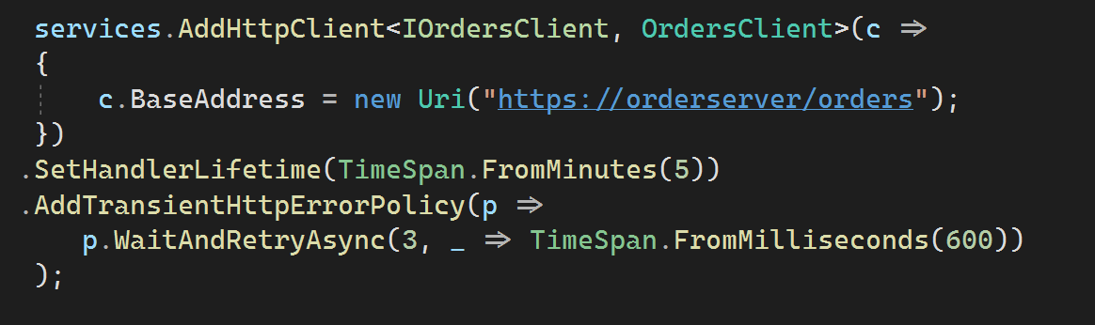
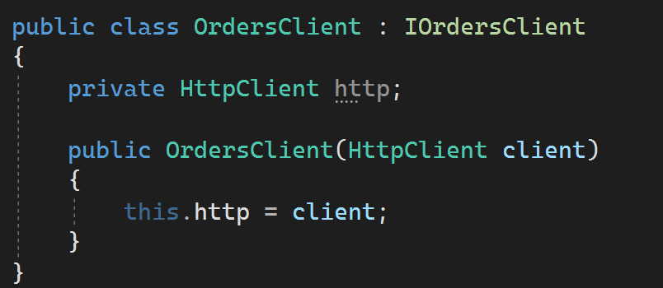
Use HttpClientFactory

Slide 21
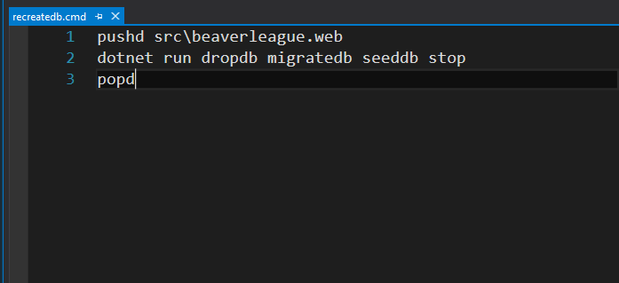
Add Scripts To Make Startup Parameters Easy

Slide 22

Project
Structure
21

Slide 23
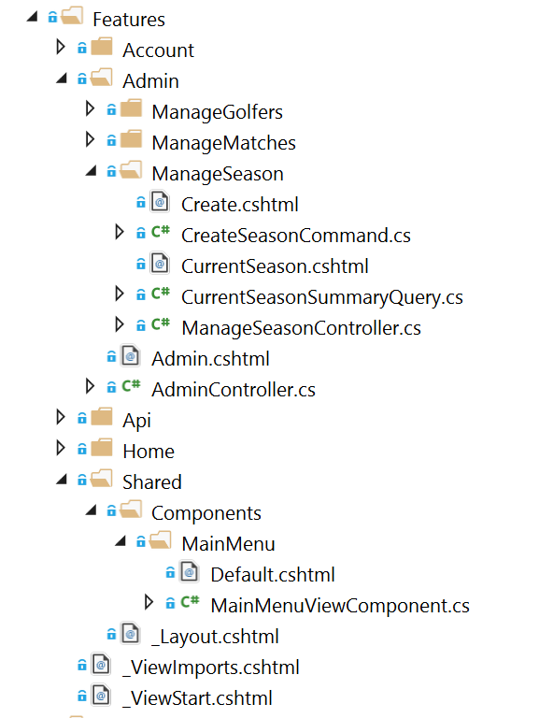
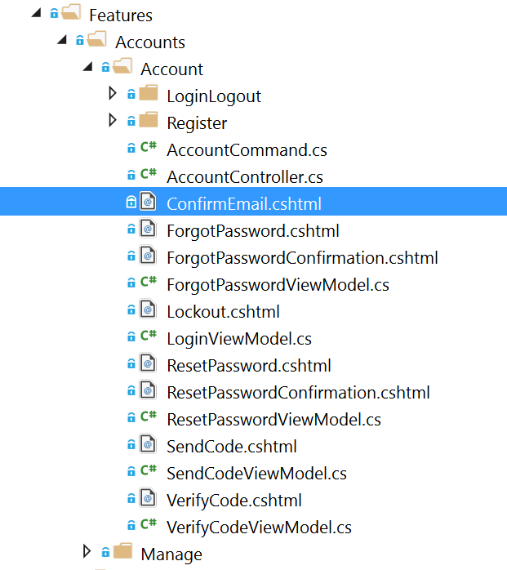
Feature Folders

Slide 24
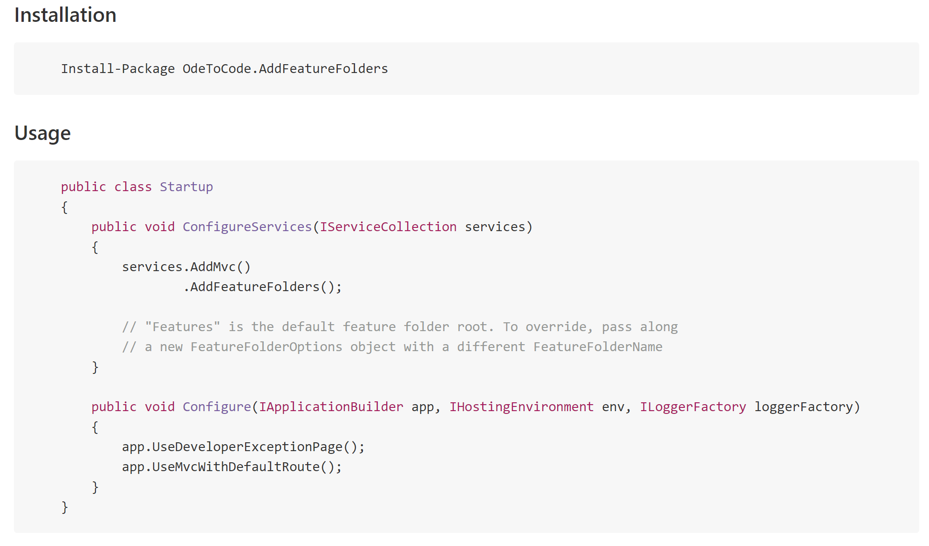
Feature Folders Are Easy

Slide 25
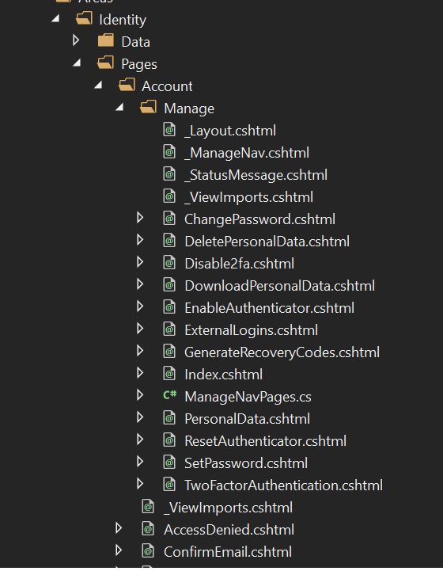
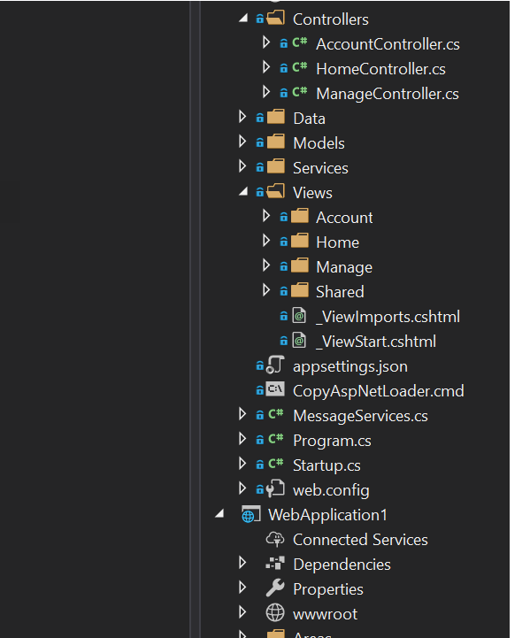
Identity Razor Pages
Identity MVC

Slide 26
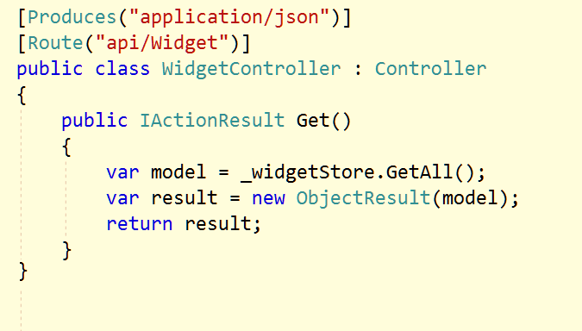
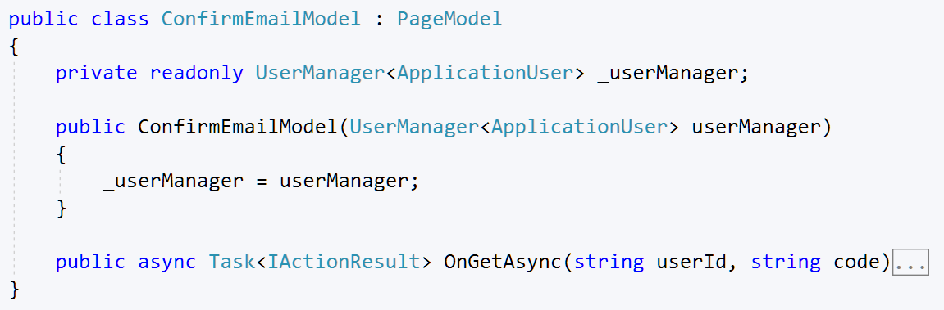
Controllers for APIs / Razor Pages for HTML

Slide 27
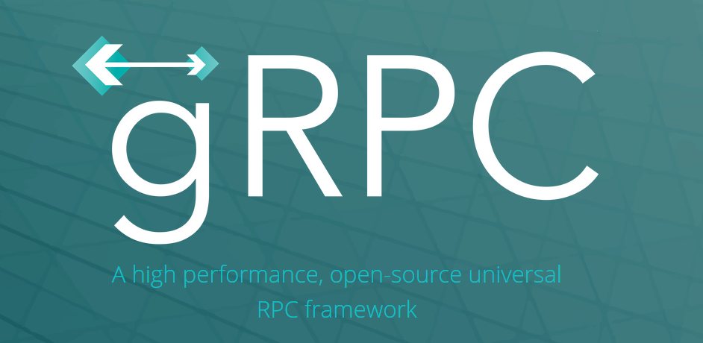
Controllers for open APIs, gRPC for closed APIs

Slide 28

Controllers
24

Slide 29
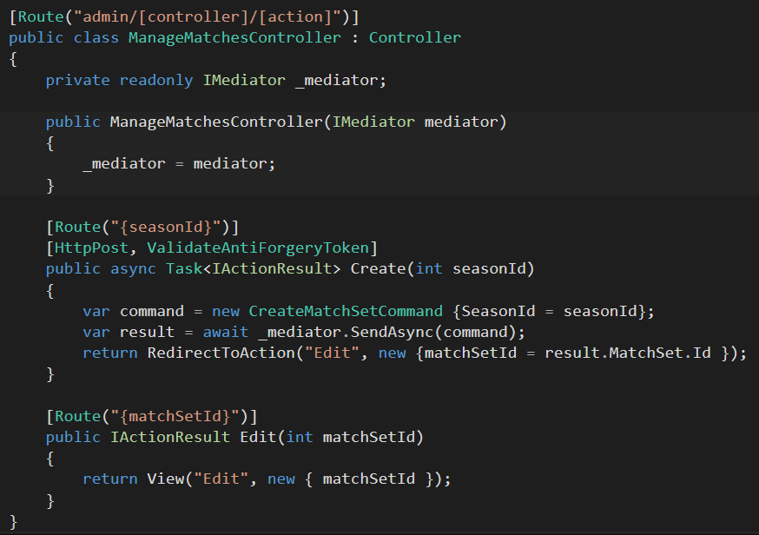
Route using [Route]

Slide 30
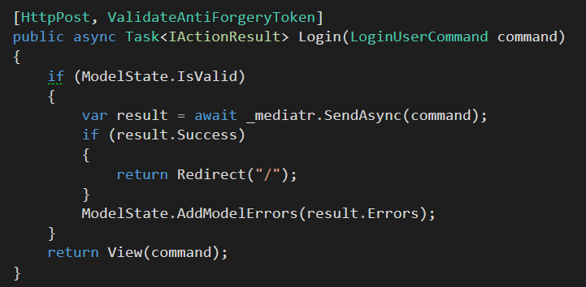
Think About Mediatr

Slide 31
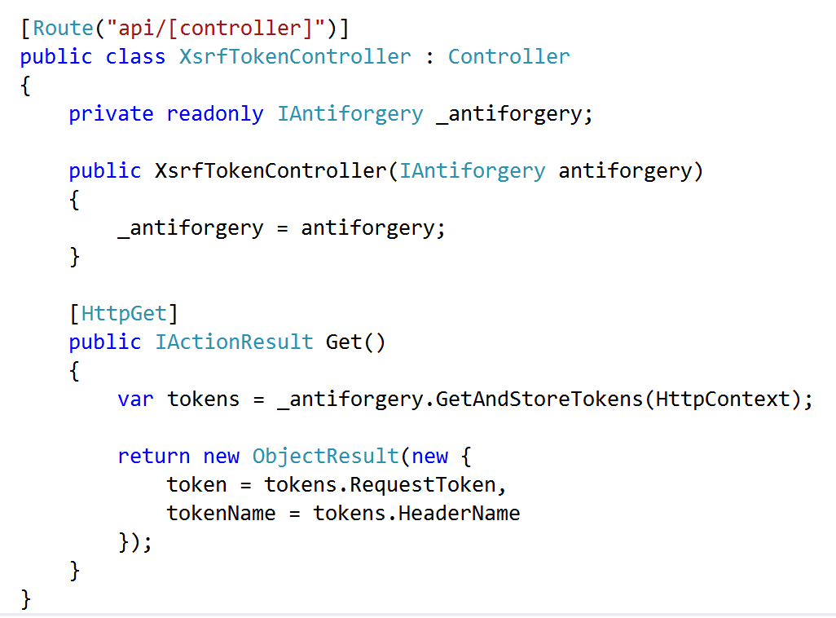
Don’t Forget XSRF in APIs

Slide 32
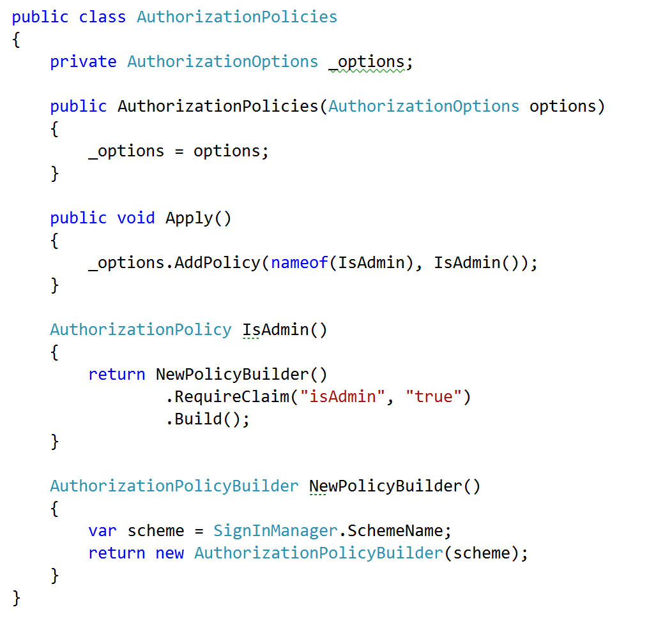
Embrace Security Policies

Slide 33
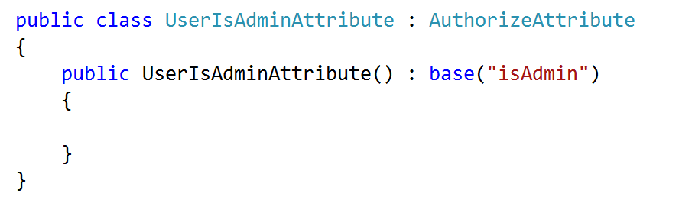
Create Custom Authorize Attributes

Slide 34

Views
32

Slide 35
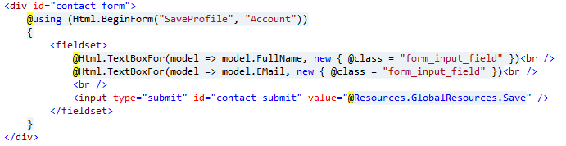
Avoid HTML Helpers

Slide 36
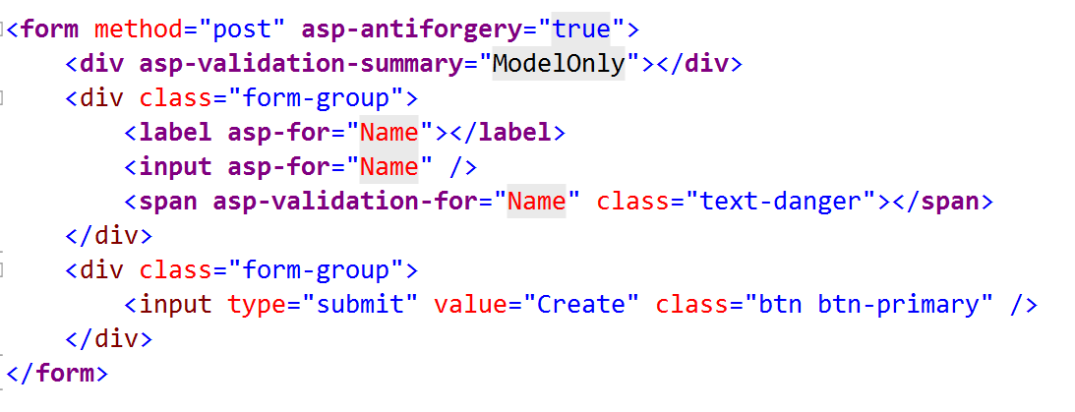
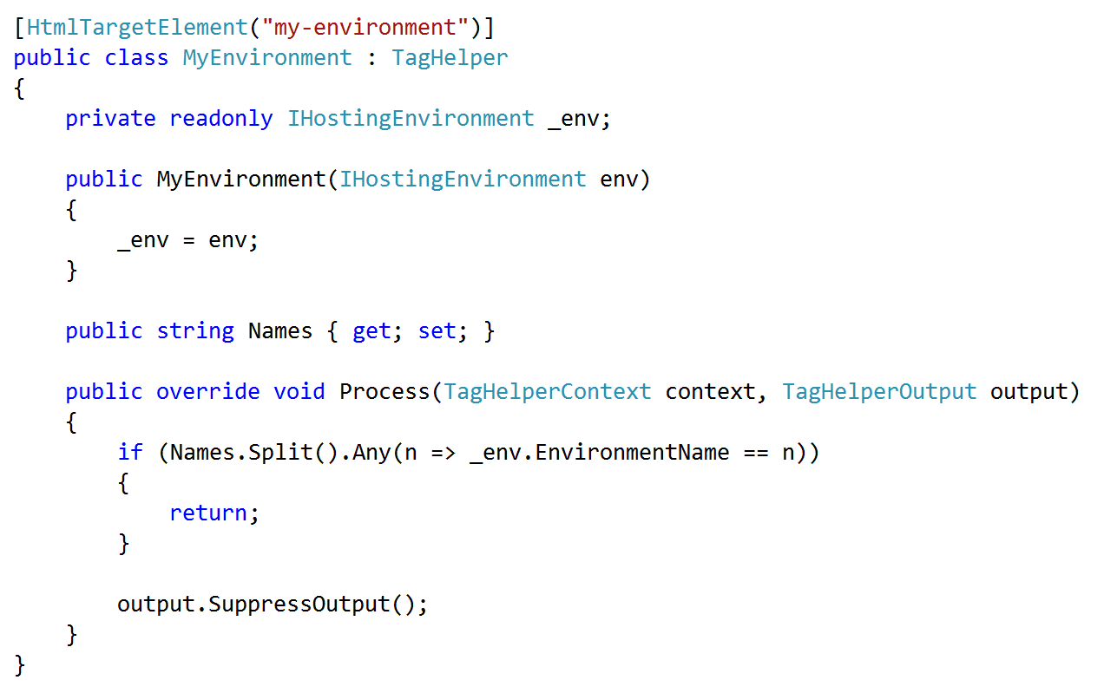
Embrace & Extend Tag Helpers

Slide 37
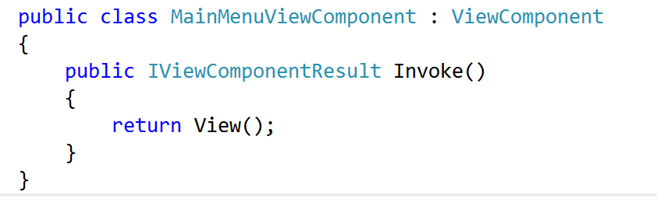
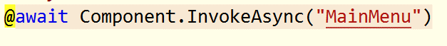
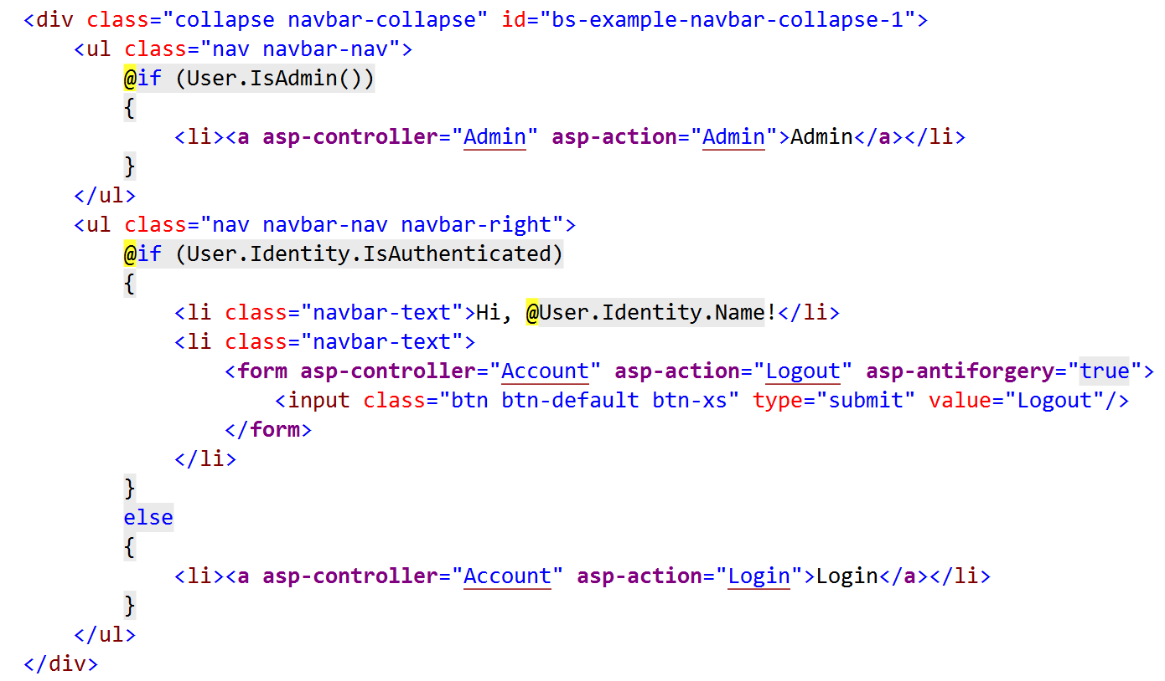
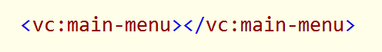
Embrace View Components

Slide 38

Data
36

Slide 39
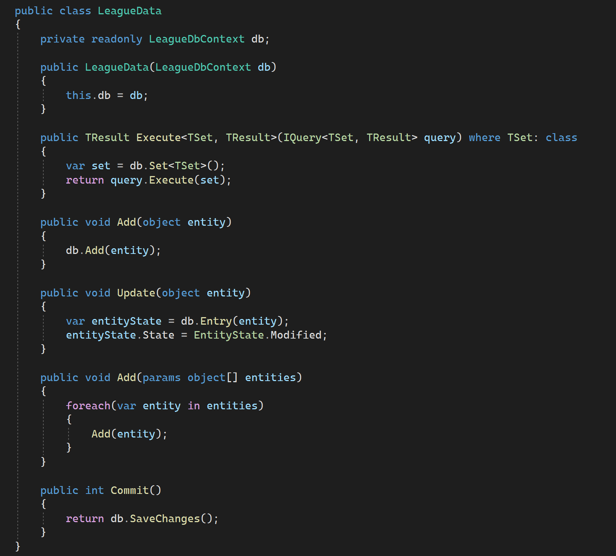

Use Query Classes

Slide 40

Think About Event Sourcing
https://docs.microsoft.com/en-us/azure/architecture/patterns/event-sourcing

Slide 41


Think About CQRS
https://docs.microsoft.com/en-us/azure/architecture/patterns/cqrs

Slide 42
Client Code
36

Slide 43

Use WebPack

Slide 44

Use WebPack

Slide 45

Use Multiple Configuration Files

Slide 46



Use ConEmu, cmder, or Terminal

Slide 47


Client Code Layout

Slide 48

NuGet and npm Only

Slide 49


Use TypeScript

Slide 50

Use Visual Studio Code for TypeScript and ES2015+

Slide 51

wwwroot is your bin\ folder

Slide 52

Testing
50

Slide 53
A Single Test Project Is Not A Bad Idea
Web
Test
-
Web
Core
BEE
Core
BEE
(background
execution engine)

Slide 54


Use xUnit
Extensible, flexible, open source
Low ceremony
Good vocabulary

Slide 55







Try Hard to Avoid Mocks

Slide 56

Use the Microsoft.AspNetCore.Mvc.Testing

Slide 57

Define a Factory

Slide 58

More Integration Tests & Fewer Unit Tests

Slide 59

Make Integration Tests Easy

Slide 60

Make Use of AngleSharp

Slide 61

C#
Code
58

Slide 62

Use Non-Nullable Reference Types

Slide 63

Use Environment.NewLine

Slide 64

Use Path.Combine

Slide 65

Be Aware of Environment Variables

Slide 66


Don’t Use the Async Suffix

Slide 67



Thanks!
scott@OdeToCode.com

Slide 68
Opinionated ASP.NET Core
How to use ASP.NET for the best results
K. Scott Allen
@OdeToCode

Slide 69






.NET Core
Fast
Cross-platform
Lightweight
Open Source
Compatible
Tools

Slide 70
The Faces of ASP.NET Core
MVC Framework
(for everything)
Blazor
(for components &
SPAs)
Controllers
(for APIs)
Razor Pages
(for HTML)
SignalR
(for Realtime)
gRPC
(for APIs)

Slide 71
Controllers for APIs / Razor Pages for HTML

Slide 72
Controllers for Open APIs, gRPC for closed APIs

Slide 73

Build Client Apps with Blazor

Slide 74
Embrace the CLI Tools & use Cmder / new Terminal

Slide 75
Try Hard to Avoid Mocks

Slide 76
Use Microsoft.AspNetCore.Mvc.Testing

Slide 77
Use Non-Nullable Reference Types

Slide 78


Thanks!

